Slide 1

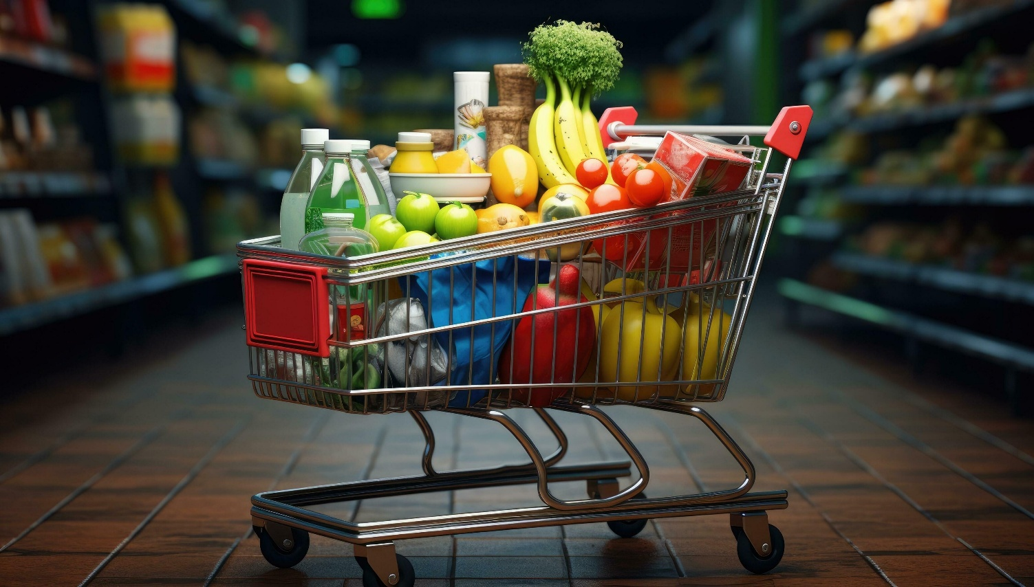
Online Grocery Billing System
Course: Introduction to Data Structures
Group no.18
Yash kharmale 69
70
71
72
Class :SOC – 15
Faculty Name:pujapwle
A.Y 2025-26 Sem II

Slide 2
Index
Introduction
Problem statement
Implementation
Conclusion
Reference

Slide 3
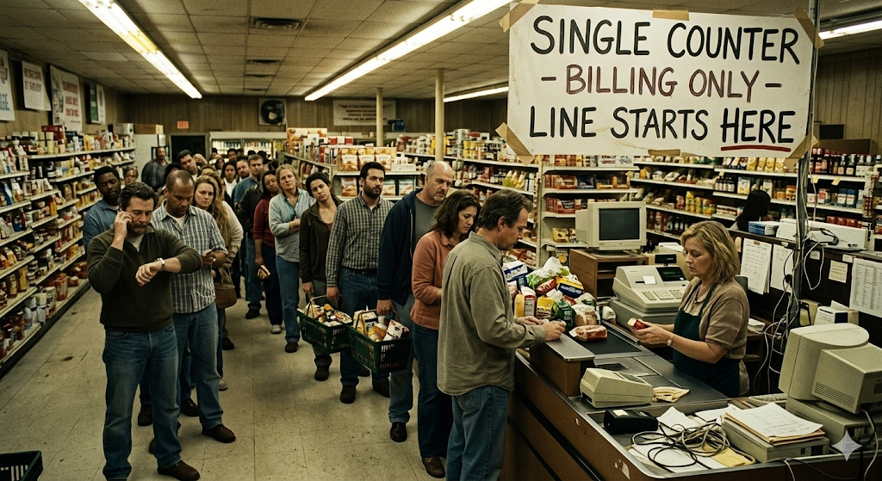
Problem Overview
Traditional Method: Customers face long queues, manual price checks, and slow billing at physical counters
The Inefficiency: Manual navigation to find items and waiting for a cashier is outdated and time-consuming. The Solution: A digital system that provides real-time item info, location tracking, transparent pricing, and instant online billing to save effort and time.

Slide 4
Problem statement
Content:
Real-time Access: Provide users with instant information on grocery availability and exact in-store locations. Dynamic Shopping: Enable users to manage a virtual cart by adding, removing, or updating item quantities on the go. Seamless Billing: Implement an automated calculation engine for subtotals, discounts, and taxes to eliminate physical queues.
Efficiency: Save customer time and effort through a fast, mobile-accessible interface.
Objective:
The primary goal is to replace the outdated, manual shopping experience with a streamlined Data-Driven Transparency: Empower customers with instant price transparency and digital record-keeping to ensure a trust-based shopping experience.

Slide 5
Implementation
Data Structure Used
Chosen Data Structure: for Store Inventory (Product Catalog): 1D/2D Array For Customer Cart: Singly Linked List
Reason for choice: Store Inventory (Array): Fast Access: Uses random access to instantly retrieve item prices and locations by their Index/ID. Customer Cart (Linked List): Dynamic Flexibility : Handles an unpredictable number of items without needing to pre-define a maximum limit Efficient Editing : Deleting an item only requires updating a pointer rather than shifting hundreds of elements in an array Optimized Billing : Provides a fast and efficient way to traverse only the items being purchased to calculate the total bill

Slide 6
System Requirements
Add / Remove / Update items
Discount handling
Tax calculation
Invoice generation

Slide 7
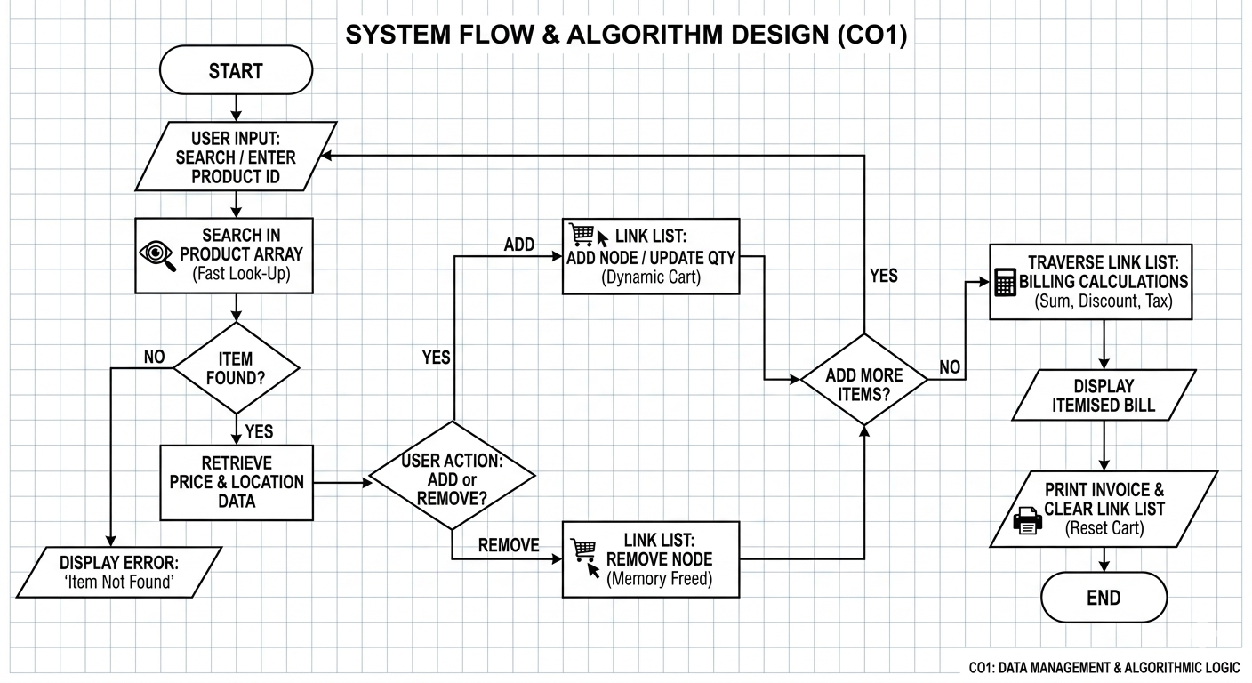
Algorithm Design (CO1)
Flow chart
Start
SEARCH
FOUND? (Yes / No)
if no (show error no item found) If yes () ,
RETRIEVE (Price/Name)
ACTION (Add/Remove)
UPDATE CART (Linked List)
Billing
Invoice
end

Slide 8
Comparison Table
Criteria | Array | Linked List
Memory Allocation | Fixed or resized | Dynamic
Insertion | Easy at end, costly in middle | Easy anywhere
Deletion | Requires shifting elements | Pointer adjustment only
Search | Linear search | Linear search
Scalability | Limited (resize needed) | Flexible
Implementation | Simple | Slightly complex
Suitable For | Small/medium cart | Frequent add/remove

Slide 9
Data Structure Usage (CO2)
3. ALGORITHMIC FLOW (CO2)
Search: Match inputID against the inventory Array.
Create: If found, allocate memory for a new Node.
Link: Attach the new node to the head of the Cart List.
Calculate:
Traverse the List: Total = (Price * Qty) - Discount.
Final: Grand Total = Total + (Total * GST)
1. STRUCTURE DEFINTION (The Node)
Data Part: itemID, itemName, price, discountPercent
Next Pointer: struct Node* next (This makes it a Linked List)
END DECLARE
2. INITIALIZATION
Inventory (Array): Product inventory[MAX]
Cart (Linked List): Node head = NULL (Start with an empty cart)
Tax: GST = 0.05 (5%)

Slide 10
Pseudocode (Part 1)
Store data 1. DEFINE the structure for a single item
STRUCTURE Item:
id AS Integer
name AS String
price AS Float
END STRUCTURE
2. INITIALIZE the static array with fixed store data
DECLARE inventory AS Array of Item
SET inventory[0] = {id: 101, name: "Milk", price: 50.0}
SET inventory[1] = {id: 102, name: "Bread", price: 30.0}
SET inventory[2] = {id: 103, name: "Eggs", price: 10.0}
SET inventory[3] = {id: 104, name: "Butter", price: 45.0}
3. Search and find
INPUT search_name
SET found_item = NULL
FOR EACH item IN inventory:
IF item.name EQUALS search_name:
found_item = item
BREAK LOOP
END IF
END FOR
IF found_item IS NULL:
DISPLAY "Error: Item not found"
ELSE:
DISPLAY "Item Found: " + found_item.name
END IF

Slide 11
Pseudocode (Part 2)
5. Final invoice SET current = head
SET subtotal = 0
WHILE current IS NOT NULL:
total_price = current.price * current.qty
DISPLAY current.name, current.qty, total_price
subtotal = subtotal + total_price
current = current.next // Move to next node
END WHILE
SET tax = subtotal * 0.05
DISPLAY "Grand Total: " + (subtotal + tax)
4. Loop logic LOOP:
// Run Search and Add Steps here...
INPUT choice ("Add more items? yes/no")
IF choice EQUALS "no":
BREAK LOOP
END LOOP
if choice equal “yes”: go to search again and loop continues

Slide 12
Justification (CO3)
1. Why use an Array? (The Inventory)
Where: Used to store the Master Product List (the store's database).
Why: * Fixed Data: The items sold in the store (ID, Name, Price) do not change frequently during a transaction.
Search Efficiency: Arrays provide a structured way to perform a Linear Search to find product details by name or ID.
Low Overhead: Since the number of products is usually known, an array is the simplest way to keep this data "Read-Only."
2. WHY USE A LINKED LIST? (The Billing Cart)
WHERE: Used to store the customer's selected items and quantities.
WHY: - Dynamic Growth: We don't know if a user buys 1 or 100 items; Linked Lists grow as needed.
- Insertion: Adding a new item to the 'Head' is instant, regardless of cart size.
- Efficiency: No pre-allocation of memory is required (unlike an array like cart[1000]).
- No Shifting: Removing an item only requires changing a pointer, not moving all data.

Slide 13
Conclusion
Summary of approach
Feature | Inventory (Array) | Billing Cart (Linked List)
Data Type | Static / Fixed | Dynamic / Growing
Memory | Contiguous (Blocks) | Non-contiguous (Scattered)
Insertion | Difficult (if size limit hit) | (Instant at Head)
Best Use | Looking up Prices | Adding/Removing Items

Slide 14
Key learnings
Hybrid Data Structures: Combined Static Arrays (Inventory) with Singly Linked Lists (Cart).
Memory Management: Used dynamic node allocation to save RAM
Time Efficiency: Implemented insertion logic for the billing process
Pointer Logic: Mastered using next pointers to link and traverse data blocks.
Input Validation: Built robust loops to handle user errors and invalid data.
Final decision
Optimal Architecture: Selected a hybrid model combining Arrays for search speed and Linked Lists for storage flexibility.
Scalability: Chose Linked Lists to allow the billing cart to grow indefinitely without pre-allocating memory
Performance Guarantee: Prioritized insertion logic to ensure the system remains fast as the bill gets longer.
Data Reliability: Used a static inventory "Source of Truth" to prevent errors in pricing and item details.
User Resilience: Incorporated mandatory validation loops to ensure the software is production-ready and crash-proof.

